Slide 1


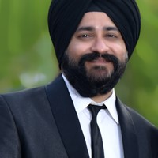


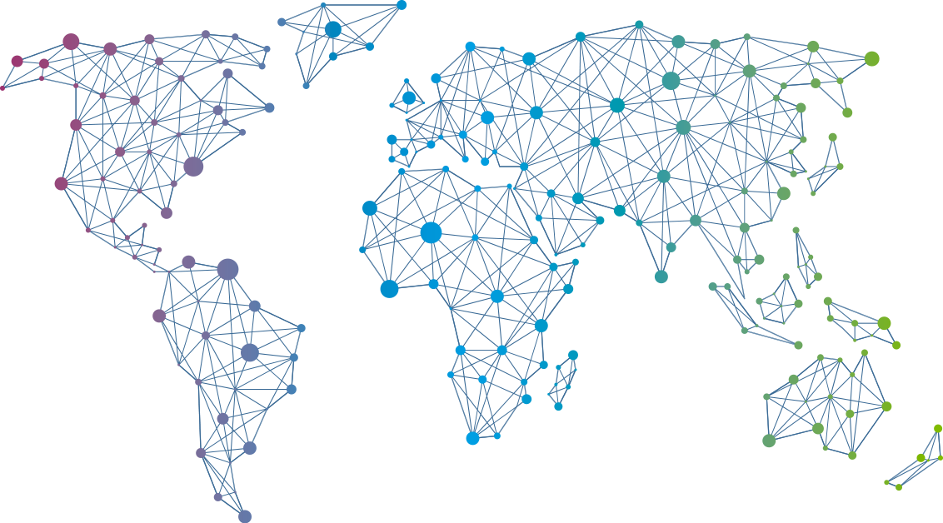

Speaker
Ajeet Raina
Delivering Container-based Apps to IoT Edge devices
Ajeet Raina
ajeetsraina
September 16th & 17th
^{Online Event}
Powered By
International Conference

